Slide 1
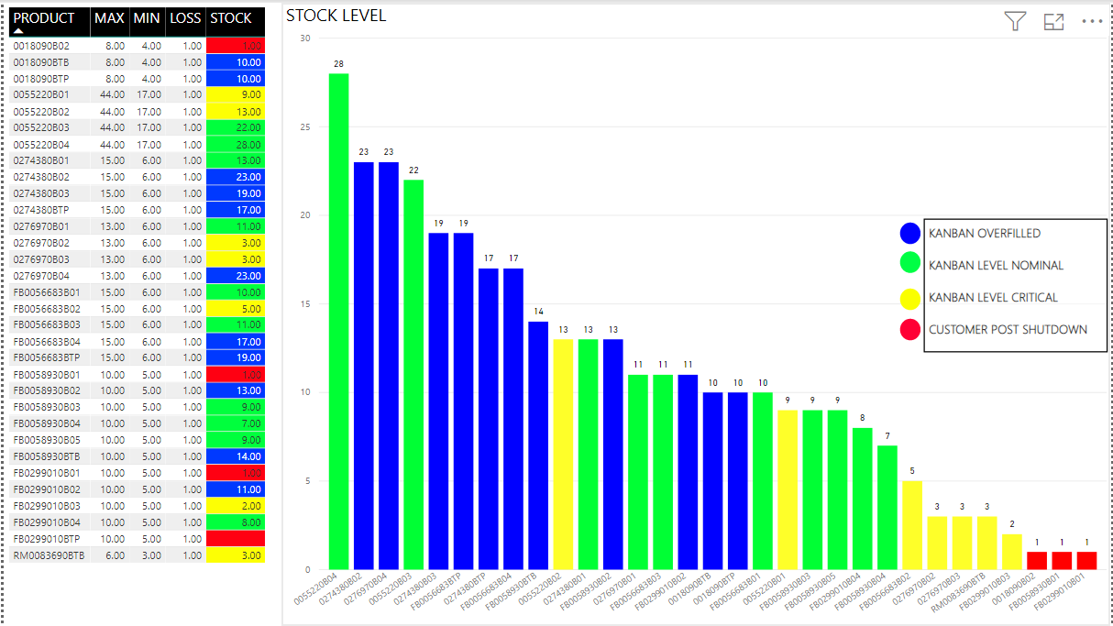
Stock Level Tracking

Slide 2
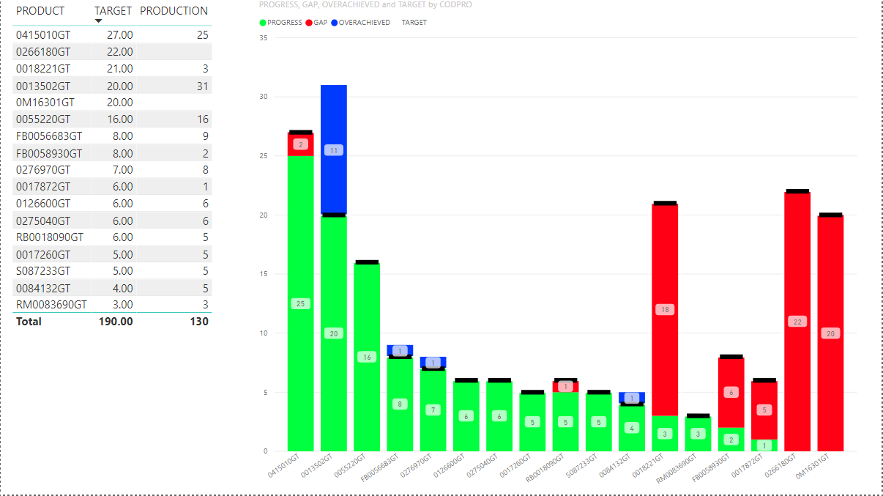
Production so far today vs the daily target

Slide 3
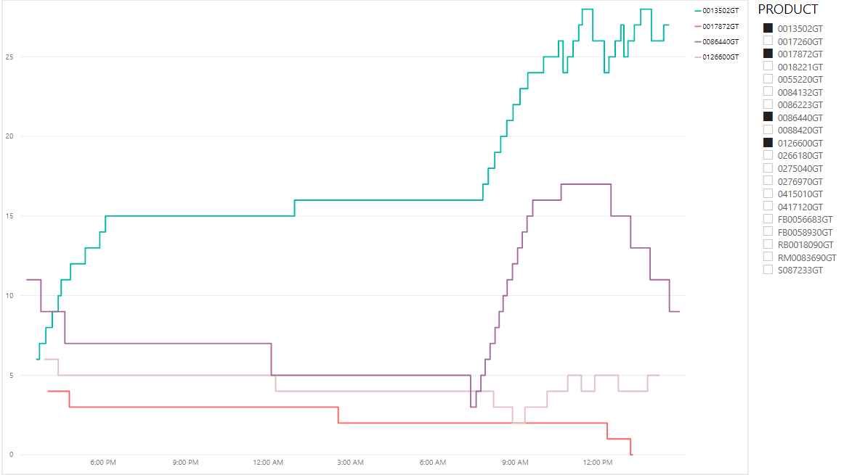
Stock Level Trends Over Time

Slide 4
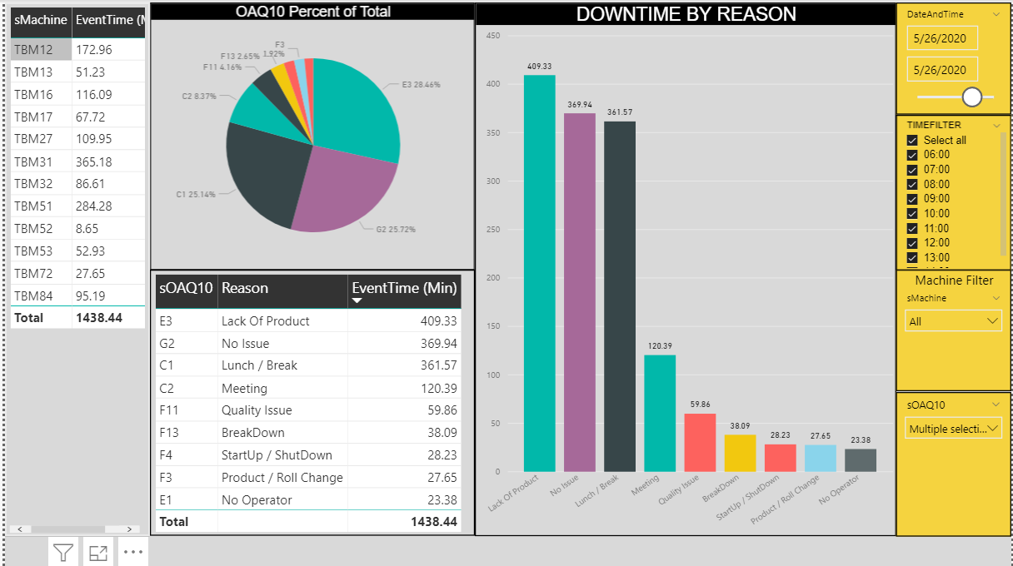
Downtime

Slide 5
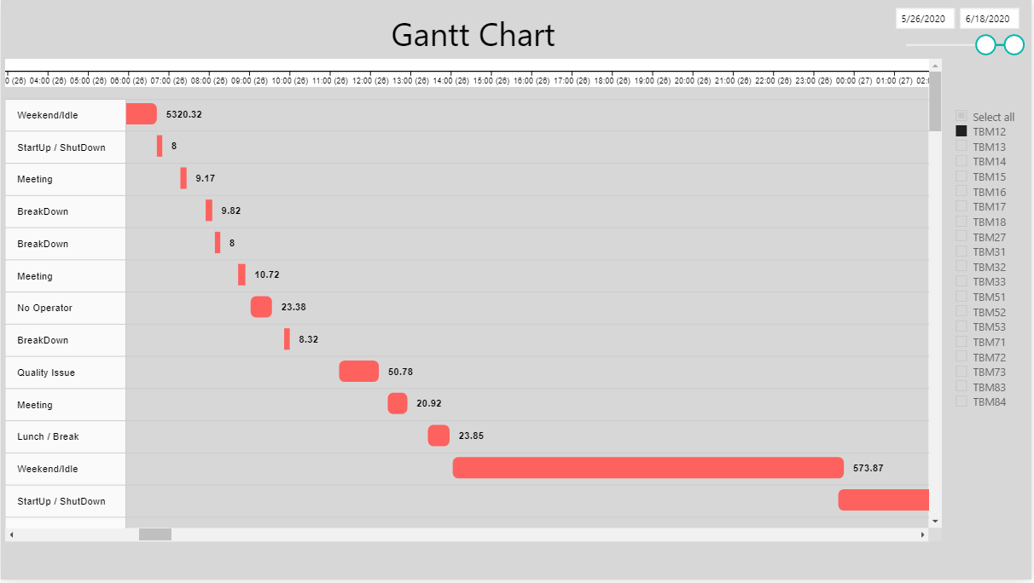
Downtime Gantt Chart

Slide 6
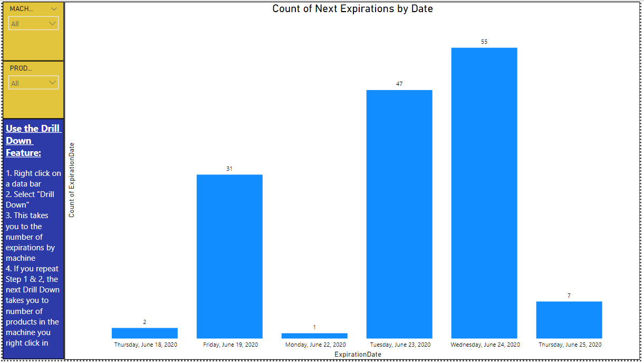
Tracking Expiring Materials with Drill Downs

Slide 7
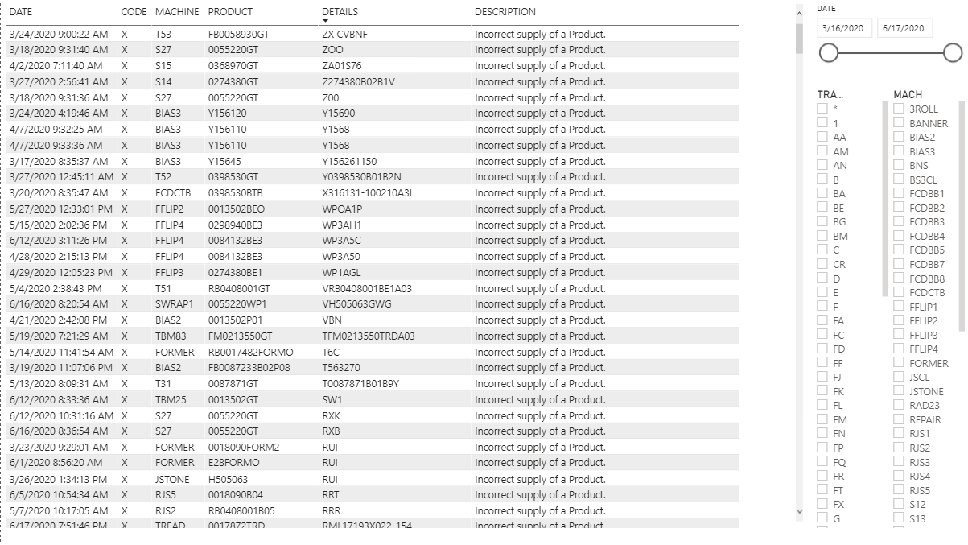
Error Code Tracking for Accountability and Data Quality

Slide 8
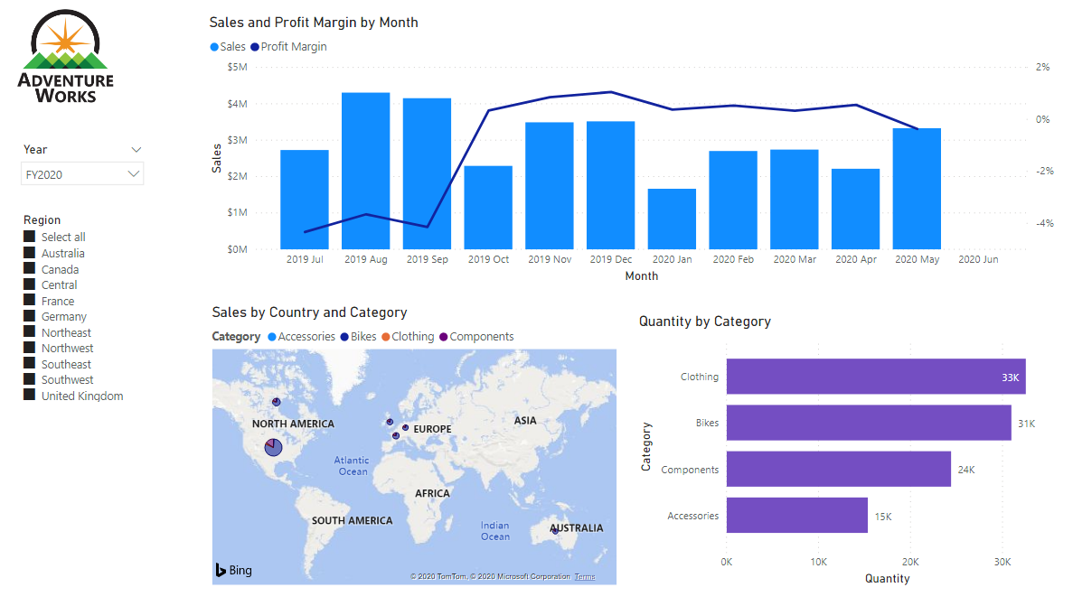
Microsoft Adventure Works Exercise

